Slide 1
Reinforcement Learning
Presented by: Almiqdad Elzein
Instructor: Dr. Yasser Alginahi
Date: November 17th, 2023
University of Windsor
1

Slide 2
Reinforcement VS Supervised and Unsupervised Learning
So Far, we have discussed input-to-variable mapping tasks
Given an input, we predict the value of a discrete or continuous variable
Discrete variables: Clustering, Classification
Continuous Variables: Regression
What about the following game-like scenario:
An agent exists in some environment with some goal
The agent's goal could be to maximize profit or win a board game
Key Question: What actions should the agent take in this environment?
2

Slide 3
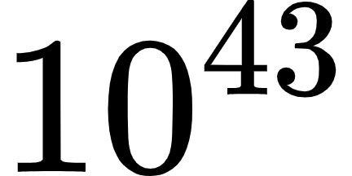
Game-Like scenarios
The actions the agent should take at any point in time depends on:
The agent's goal – e.g, winning a chess game
The state of the environment – e.g, the state of the chess board
How the agent's actions affect the environment
Main Challenge: There are around possible states in a chess board [1]
It's impossible to manually outline the state-action mapping
Can the mapping be learnt?
Reinforcement Learning (RL) solution: play and learn!
3

Slide 4
Rewards – The Driver of Learning
In RL, the agent gets rewards for its actions
Large rewards imply good actions while small rewards imply worse actions
The reward signal allow the agent to learn the right actions to take given the current state
An agent maintains a policy telling it what action to take based on the state of the environment
An agent in RL adjusts its policy based on the rewards it received
4

Slide 5
Reinforcement Learning Definition
RL is an online learning paradigm for decision-making [2] where an agent:
takes actions in the environment based on its policy
Gets rewards for its actions
uses those rewards to update its policy
Go back to step 1
This process is known as a Markov Decision Process [3]
MDPs assume that only previous actions effect the state
An agent may learn a sequence of actions to reach its goal – an eye for the future
Supervised and Unsupervised Learning have no consideration of future "decisions"
5

Slide 6
Why RL As a Learning Paradigm?
Assume that we are able to implement a RL agent to act in some environment, what would we achieve?
We would be able to estimate the state-action mappings in evolving environments
Is this "learning"?
Yes, we learn a good policy by repeatedly taking actions and updating our policy based on the rewards
This is similar to updating weights to minimize loss in Deep Learning
6

Slide 7
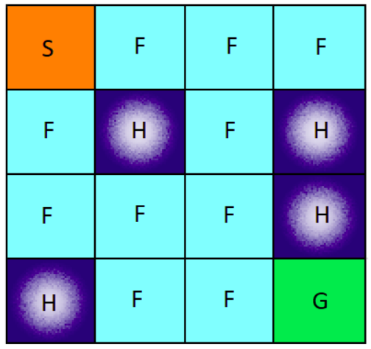
Example – Frozen Lake
(0)
(1)
(2)
(3)
Goal: Maximize Reward
States: 16 possible states depending on agent's location (unchanging environment)
Actions: Left, Right, Up, Down
Rewards: +1 for F, -10 for H, +100 for G
Designing rewards is key in RL
(4)
(5)
(6)
(7)
(8)
(9)
(10)
(11)
(12)
(13)
(14)
(15)
source: https://tinyurl.com/24zruwt3
7

Slide 8
What should Our Policy in Frozen Lake be?
The agent's goal is to find a good policy to play the game
What is a policy? A state-action mapping (wrong)
The best action to take given each of the possible states
This approach doesn't allow us to update our policy in a way that incorporates past information
The best action to take given a state is a categorical value
8

Slide 9
What should Our Policy in Frozen Lake be?
Remember our goal: To maximize reward
The reward to maximize is the cumulative reward (until the game is shut-down)
Given our goal, what action should we take?
The action that will maximize the cumulative reward given the current state
Approach: Given the current state, take the action that maximizes the cumulative reward
9

Slide 10
Q-Learning
Our policy is a table that stores the expected cumulative reward for each state-action pair
The expected cumulative reward of a state-action pair is the Q-value of that state-action pair
Q-Learning is an approach where a Q-table is maintained and updated for all possible state-action pairs
10

Slide 11
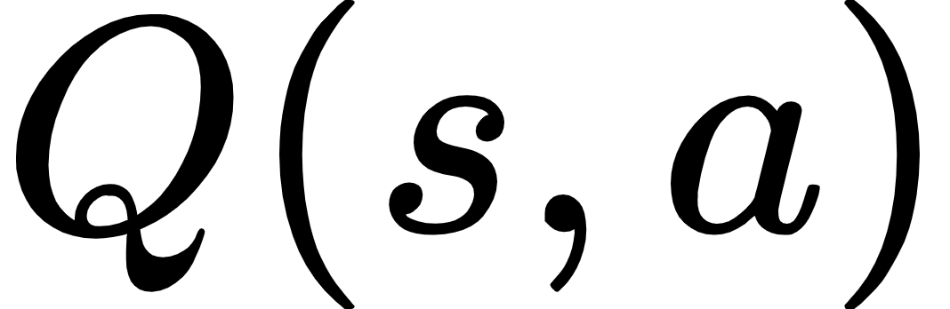

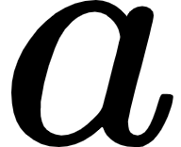
The Q-table in Frozen Lake
Below is a sub-set of the Q-table (our policy) from the Frozen Lake game where all values are initialized to 0
is the expected future return that results from being in state and taking action
 | LEFT | Right | UP | Down
State 0 | 0 | 0 | 0 | 0
State 1 | 0 | 0 | 0 | 0
State 2 | 0 | 0 | 0 | 0
State 3 | 0 | 0 | 0 | 0
11

Slide 12
Our First move in Frozen Lake (Take an Action)
We start at state 0
Since all actions have an equal Q-value at state 0, we choose a random action
Assume we go RIGHT
We observe a reward of +1
Next: Update Q-table
 | LEFT | Right | UP | Down
State 0 | 0 | 0 | 0 | 0
State 1 | 0 | 0 | 0 | 0
State 2 | 0 | 0 | 0 | 0
State 3 | 0 | 0 | 0 | 0
12

Slide 13
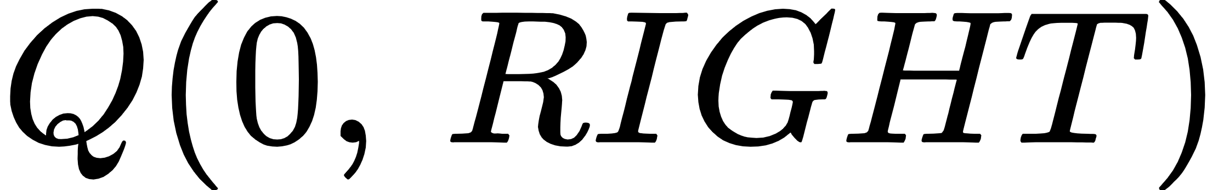
Our First move in Frozen Lake (Update the Q-table)
The goal is to combine old information (current Q-value) with new information (new Q-value)
We know the current , what should be its new value?
We want to compute the new estimate of the cumulative return based on the new observed reward
The new estimate for the cumulative return is the reward + best cumulative return of the next state - State 1 (since we moved right from State 0)
New estimate for : +1 +
13

Slide 14
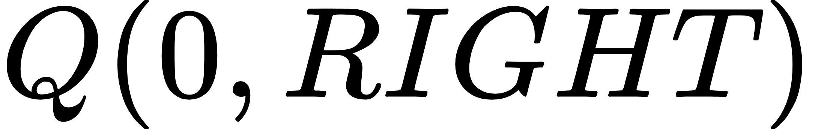
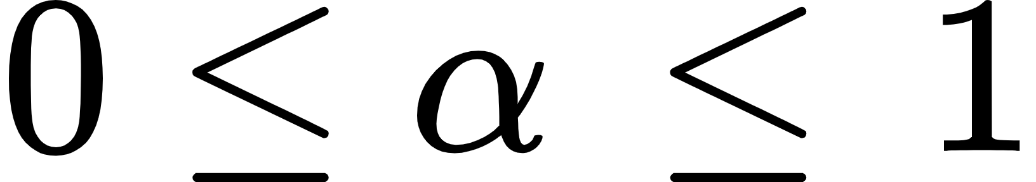
Our First move in Frozen Lake (Update the Q-table)
Principle of learning: combine new information with old information
The updated is obtained from the above values as:
and is known as a learning rate
14

Slide 15
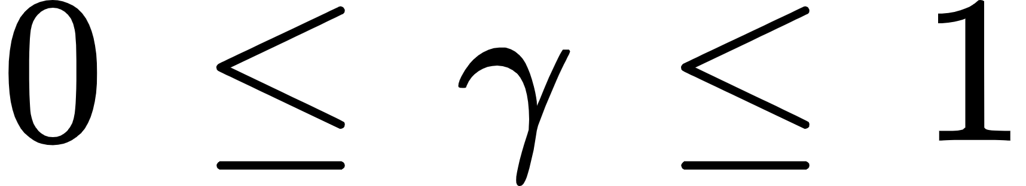
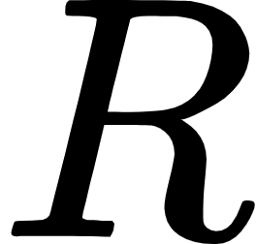
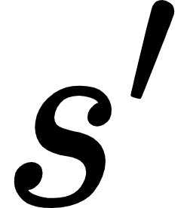
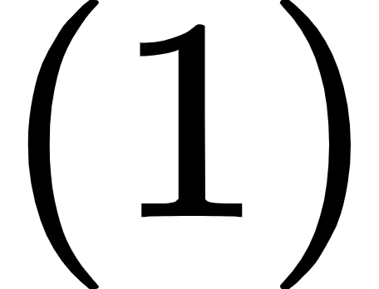
Our First move in Frozen Lake (Update the Q-table)
Since future rewards are uncertain, we discount them when updating Q-values
We redefine , where
Introducing this discount also prevents Q-values from growing out of control
In Summary, taking action in state and observing a reward and as the reward and next state, we update as follows:
15

Slide 16
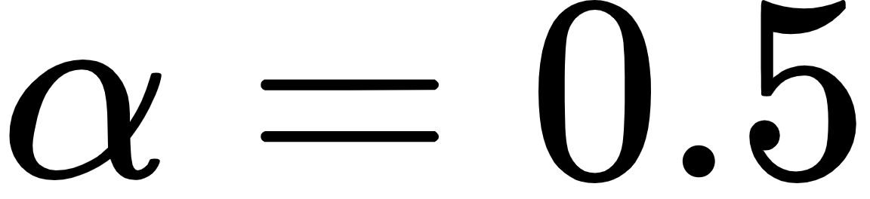
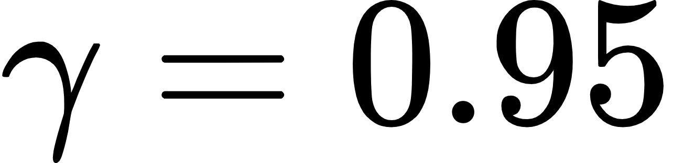
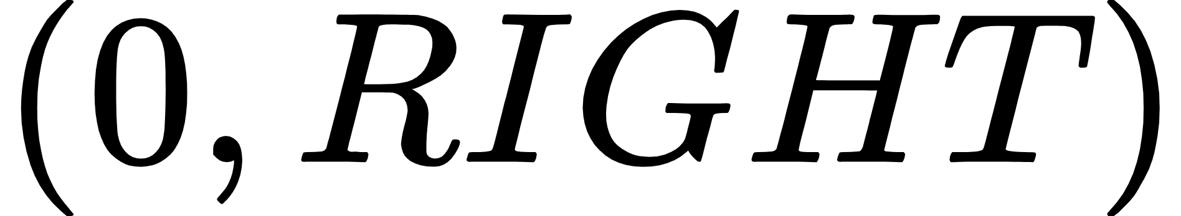
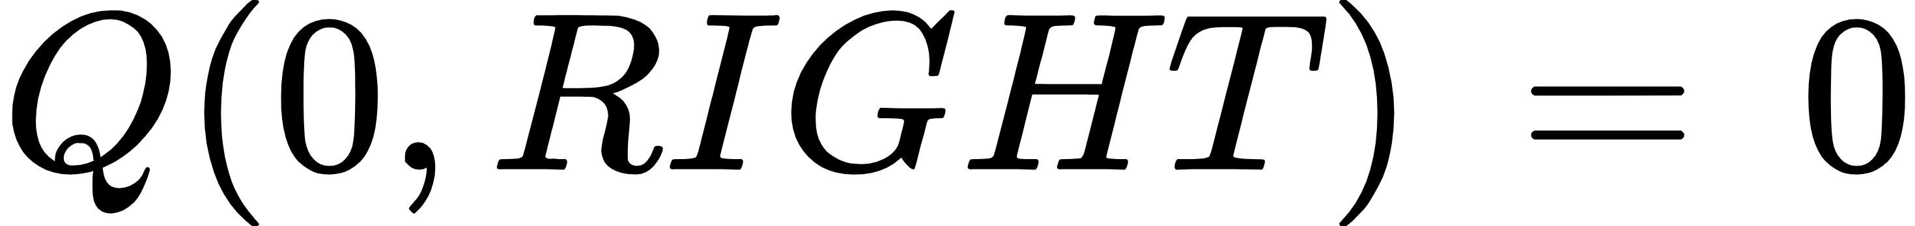
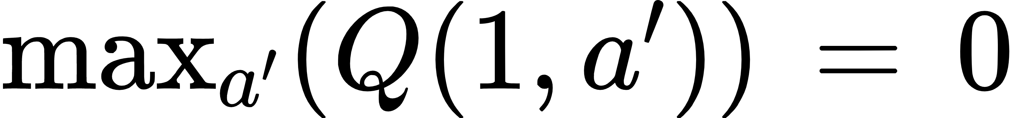
Our First move in Frozen Lake (Update the Q-table)
Assume and , and since:
Then the updated Q-value for becomes:
Where and (from Q-table)
Thus,
16

Slide 17
Our First move in Frozen Lake (Update the Q-table)
The new Q-table will become as follows:
When another action is taken from state 1, the same updating process for the Q-table will take place
 | LEFT | Right | UP | Down
State 0 | 0 | 0.5 | 0 | 0
State 1 | 0 | 0 | 0 | 0
State 2 | 0 | 0 | 0 | 0
State 3 | 0 | 0 | 0 | 0
17

Slide 18
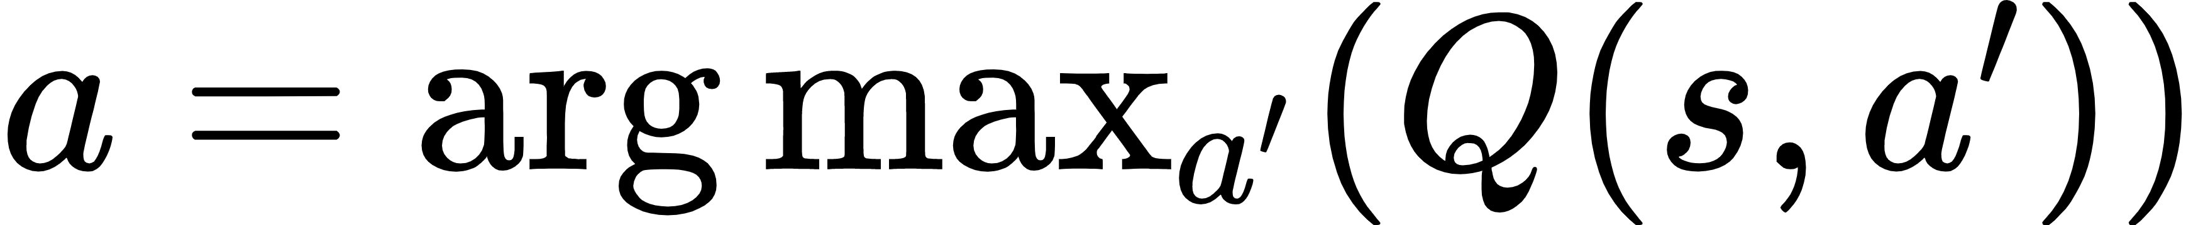
The Q-Learning Loop
Q-learning is a potentially-infinite process where the agent
Given , takes an action such that
Observes reward and the new state
Updates based on in slide 15
Go back to step 1
(1)
Agent
Environment
(2)
18

Slide 19
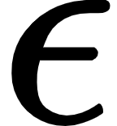
Counteracting a Greedy Strategy
With time, some paths will be favored by the agent since they have high Q-values
This will prevent the agent from exploring new territory in the state-action space
Following the Q-table is exploiting learnt information, can we encourage exploring other states?
With some probability , take a random action – epsilon greedy strategy
One smart approach is to decay with time (exploit more with more info)
19

Slide 20
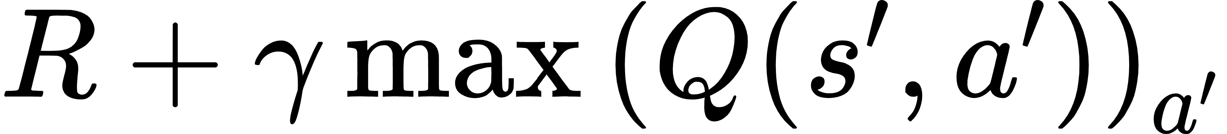
Why does Q-learning work?
Recall the Q-value updating function:
Through iterative updating, approaches
The value of will be different each time, so the Q-value approaches the true average of
When reaches this true average, it will continue to be oscillating close to this average; learning will be completed
20

Slide 21
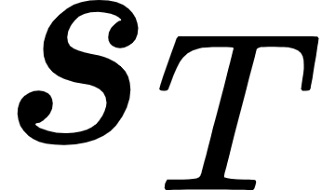
Updating Q-values based on a Trajectory (Episodic Rewards)
Assume that a trajectory of state-action pairs lead to some reward
E,g:
A chess move doesn't give an immediate reward
Episode: a trajectory where the final state is some pre-defined
Our goal is to update based on
Credit Assignment Problem: The problem of finding which action(s) resulted in the reward
21

Slide 22
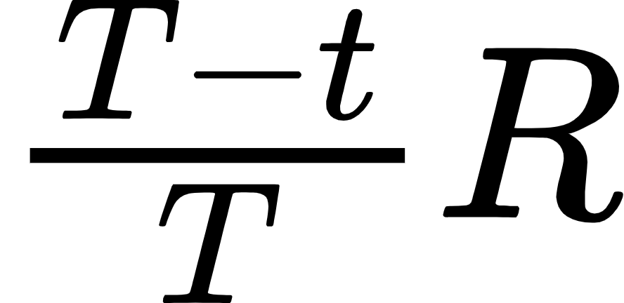
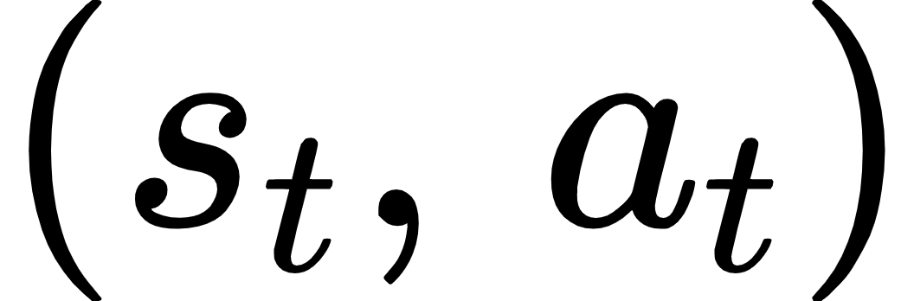
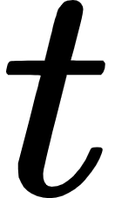
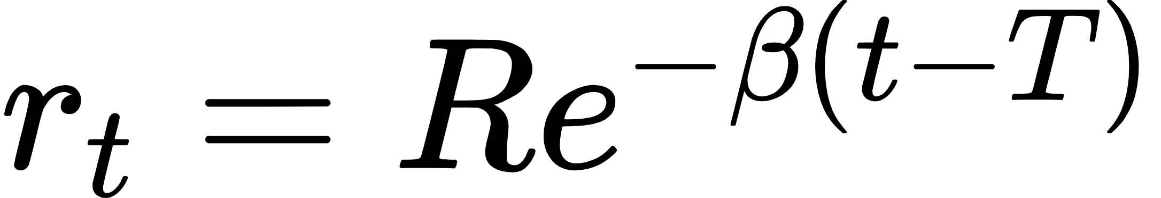
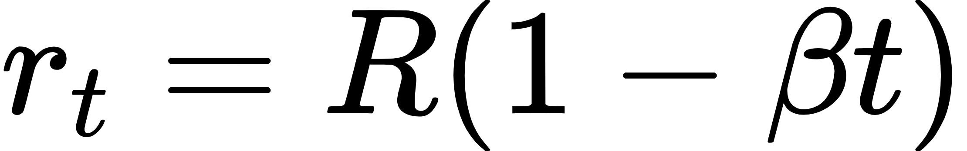
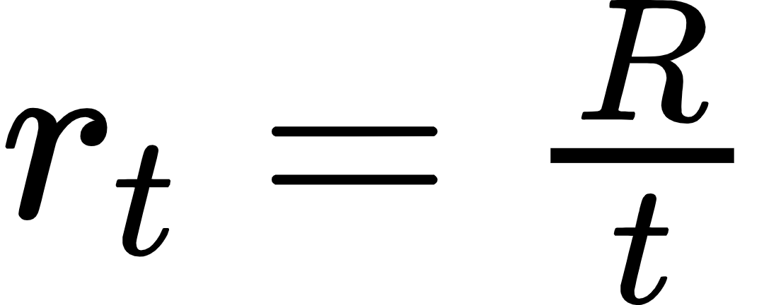
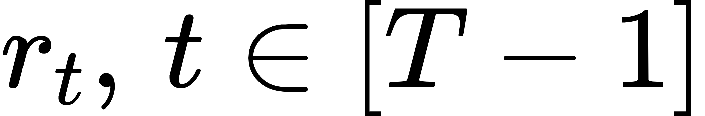
Solving the Credit Assignment Problem
Approach:
is the estimated cumulative reward of
We are assuming all actions are equally-responsible for the reward
This approach is named Monte Carlo Learning [5]
Approach 2: re-distribute the rewards to the state-action pairs (reshaping) [6]
Exponential decay: Reward at time is given by
Linear decay:
Extrapolation:
After all are computed, the Q-table can be updated via
22

Slide 23
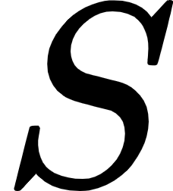

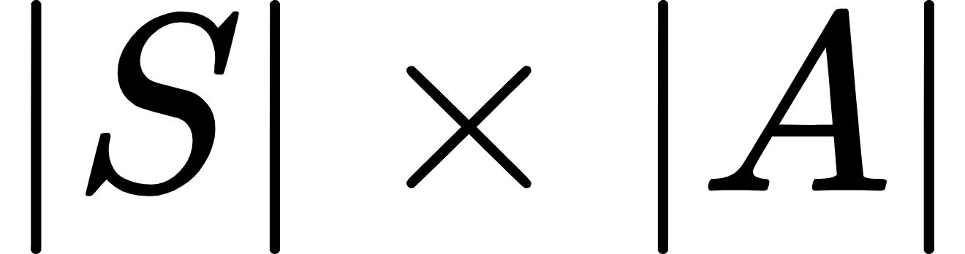
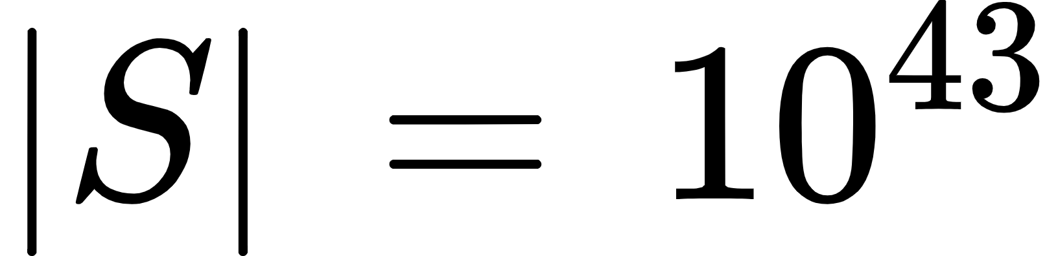
Very Large Q-Tables
In RL, is the set of all states and is the set of all possible actions
The Q-table has values
In chess
In other scenarios and may be infinite sets (continuous variables)
A self-driving car whose action space is the speed and steering angle of a wheel (infinitely-many possible actions)
The joint angle of a robotic arm (infinitely-many possible states)
With large state and action sets, we represent as an adjustable function with 2 inputs through a Neural Network – Deep Q-Learning (DQL)
23

Slide 24
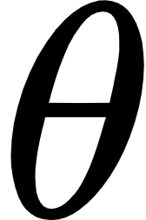
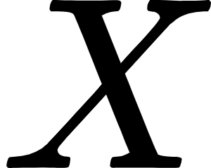
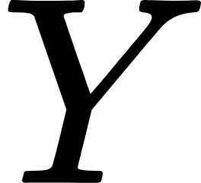
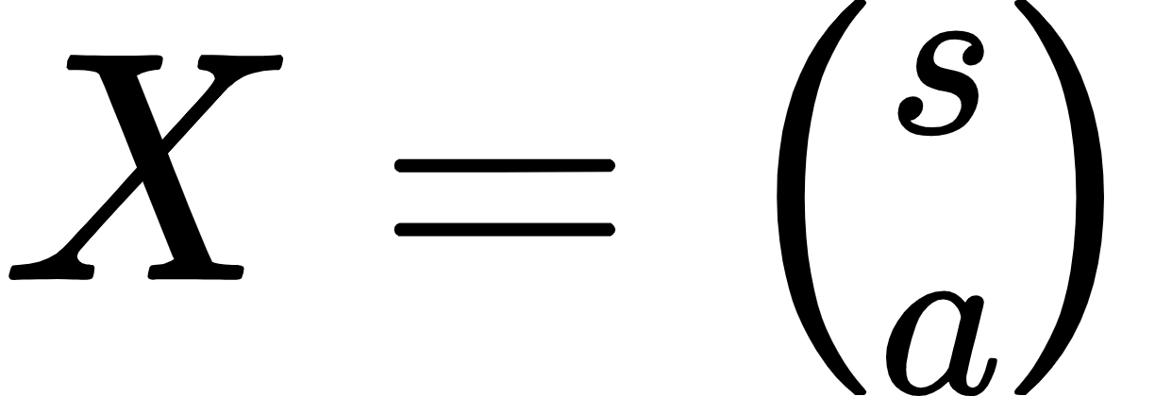
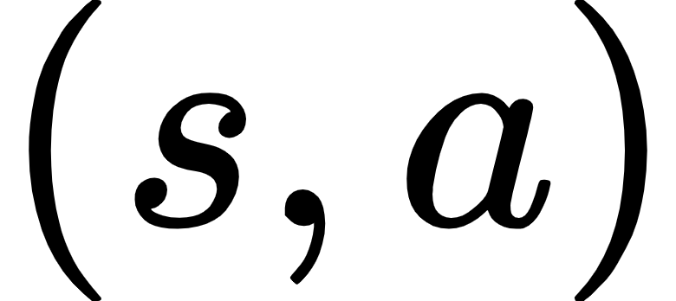
Neural Networks as functions
A neural network with parameters (weights and biases) transforms an input into an output vector
A Q-table transforms into , the cumulative return of
Thus, the Q-function can be implemented through a Neural Net (a Q-network)
One condition: Can we identify the "ideal" output for any input ?
24

Slide 25
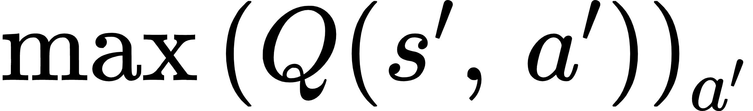
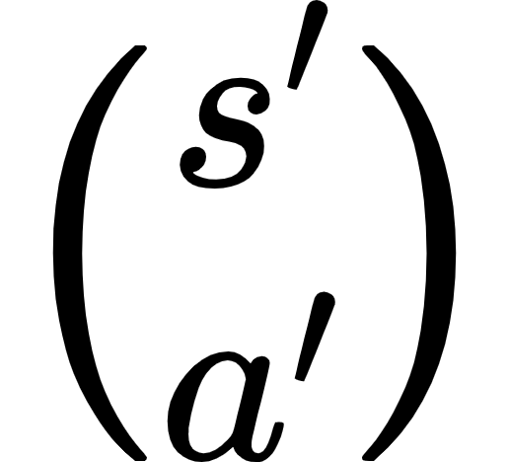
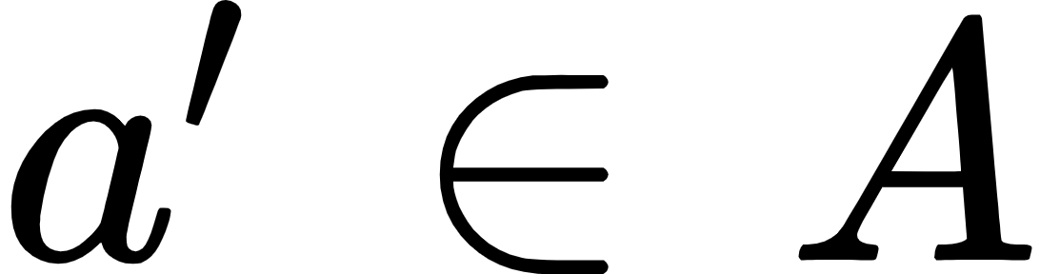
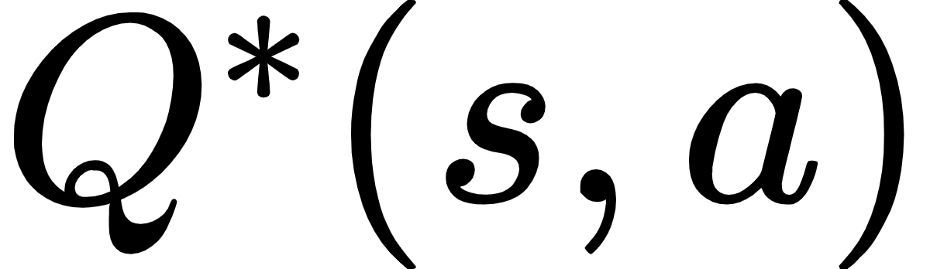
Loss For a Q-Network
Recall , the updating rule of the Q-value:
Clearly, the target value for is
We compute by passing to the network for each and finding the maximum Q-value
The Q-network is updated based on the loss between and
25

Slide 26
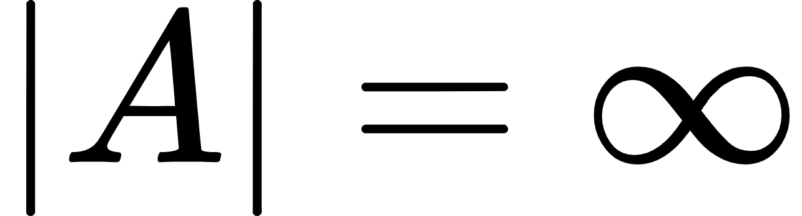
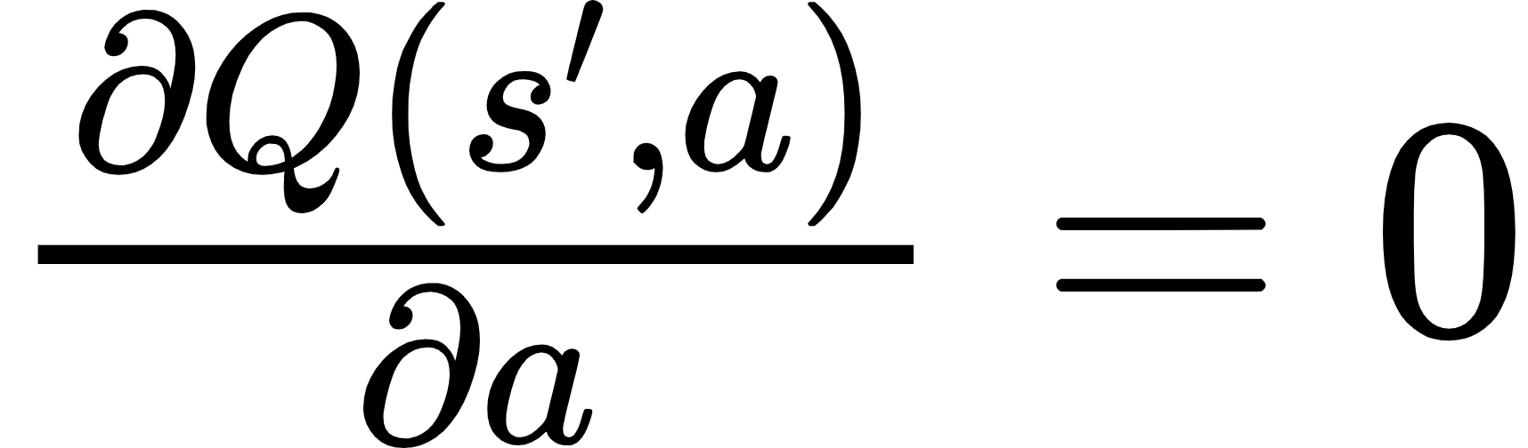
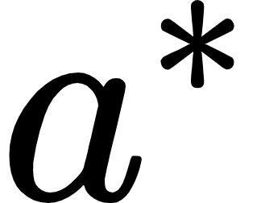
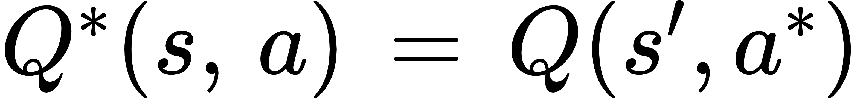
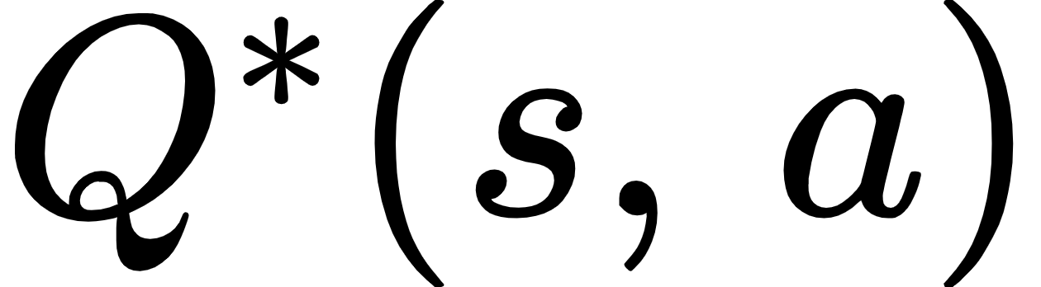
Loss For a Q-Network with an infinite actions space
We compute by passing to the network for each and finding the maximum Q-value
If , then we use gradient-based optimization: to find
Recall that a Neural Network computes gradients
Then,
Summary: (1) take action based on (2) get and (3) get (4) update network and state (5) repeat
26

Slide 27
Conclusion
Reinforcement Learning is a branch of Machine Learning where the goal is to find the best action policy of an agent existing in some environment
Q-Learning is a method of RL where the agent updates a table of Q-values of all possible state-action pairs
The Q-value of a state-action pair is the expected cumulative return resulting from being in some state and taking some action
Q-Learning is used in Robotics, Games, and development of self-driving cars
27

Slide 28
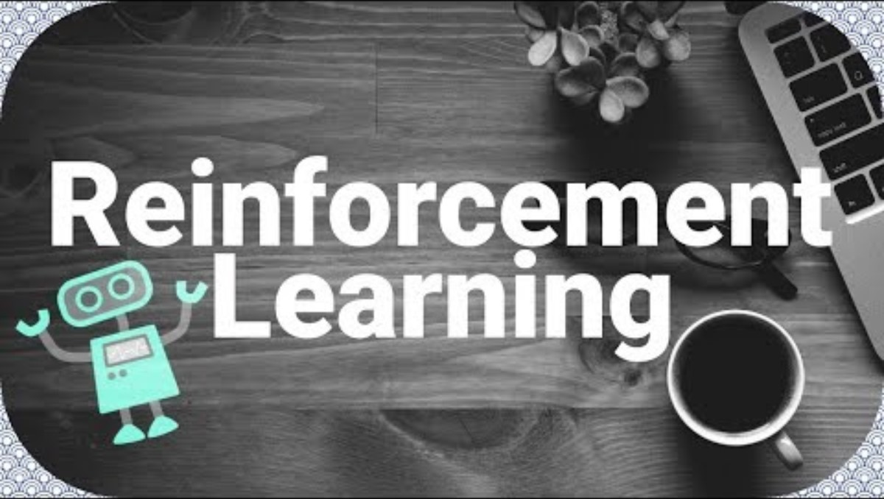
Video for Q-Learning
https://youtu.be/qhRNvCVVJaA?si=D--w6AU8LIUfRky1
28

Slide 29
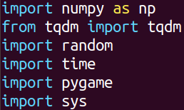
Implementing Q-Learning – Essential Libraries
29

Slide 30
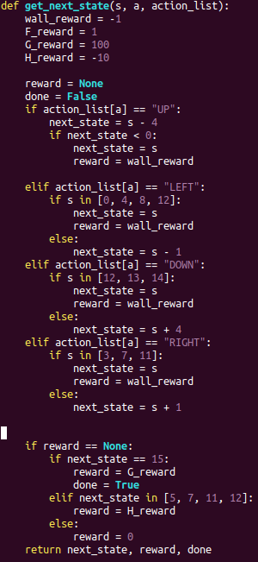
Implementing Q-Learning – Defining state-transition function
Given a state and action, return the next state and reward
30

Slide 31
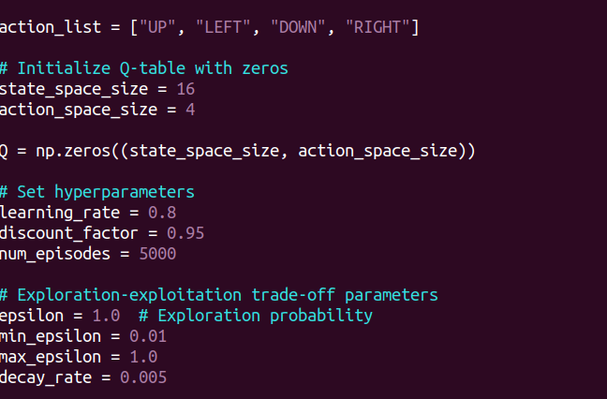
Implementing Q-Learning – initialize Q-table and Define hyper-parameters
31

Slide 32
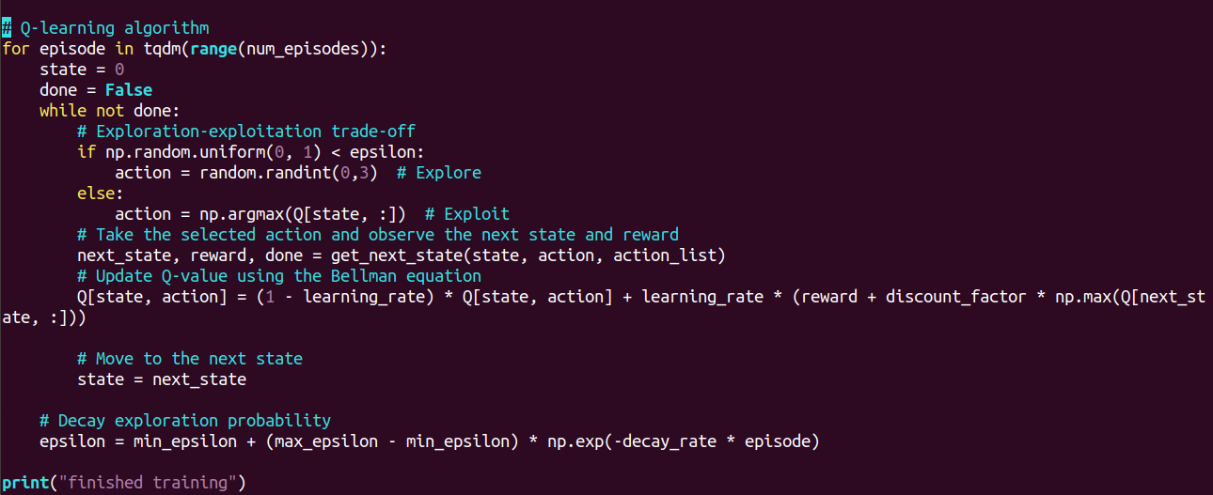
Implementing Q-Learning – Train RL Agent
32

Slide 33
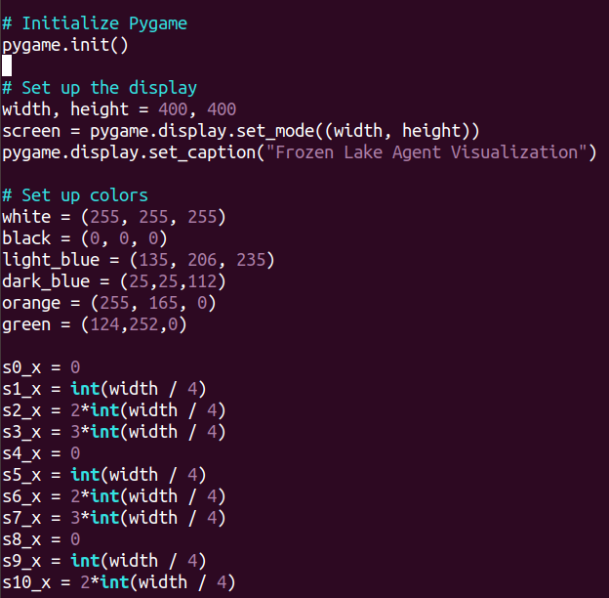
Implementing Q-Learning – Use the Trained Agent in Pygame
33

Slide 34

Implementing Q-Learning – Use the Trained Agent in Pygame (cont)
34

Slide 35

Implementing Q-Learning – Use the Trained Agent in Pygame (cont)
35

Slide 36

Implementing Q-Learning – Use the Trained Agent in Pygame (cont.)
36

Slide 37

Implementing Q-Learning – Use the Trained Agent in Pygame (cont.)
37

Slide 38

Implementing Q-Learning – Use the Trained Agent in Pygame (cont)
38

Slide 39
References
[1] S. Steinerberger, “On the number of positions in chess without promotion,” International Journal of Game Theory, vol. 44, no. 3, pp. 761–767, 2014.
[2] W. Qiang and Z. Zhongli, “Reinforcement learning model, algorithms and its Application,” 2011 International Conference on Mechatronic Science, Electric Engineering and Computer (MEC), 2011.
[3] D. J. White, Markov Decision Processes. Chichester England: John Wiley & Sons, 1993.
[4] S. J. Majeed and M. Hutter, “On Q-learning convergence for non-markov decision processes,” Proceedings of the Twenty-Seventh International Joint Conference on Artificial Intelligence, 2018.
[5] M. I. Jordan, Y. LeCun, and S. A. Solla, “Reinforcement Learning in Continuous Action Spaces through Sequential Monte Carlo Methods,” in Advances in neural information processing systems, Cambridge, MA: MIT Press, 2001
[6] W. C. J. C. Hellaby, “Learning from delayed rewards,” thesis, University of Cambridge, 1989
39

